Slide 1
LESSON SIXTEEN
TOPICS: HOW TO ANIMATE THE AMMO GRAPHIC.

Slide 2
Class Activity!
Notes:
Introduce the class to the concept of an array. A good example is to use chairs as the array and students as the values stored in the array.

Slide 3
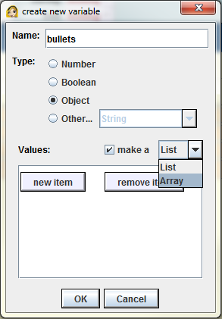
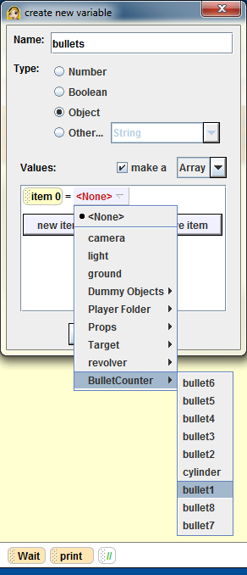
Step 1: Create the Bullets Array
Create a new world array variable called “bullets” to keep track of which is the next bullet to be shot.
Click on the “create new variable” button under world properties.
Type “bullets” for the name of the new variable.
Select “Object” for type.
Click on the check box to the left of “make a.”
From the drop down menu to the right of “make a,” select Array.
Click on the “new item” button.
Open the drop down menu for “item 0” and select “bullet1.”

Slide 4
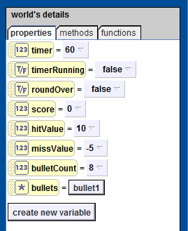
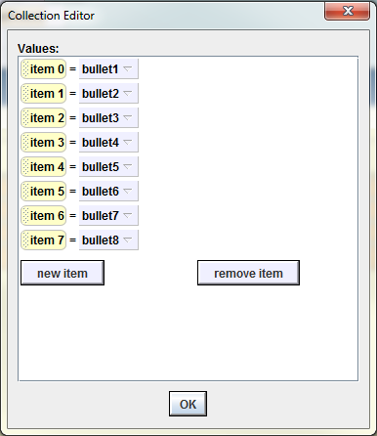
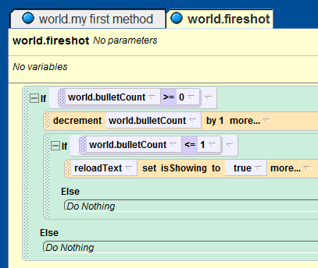
Step 2: Populate the Bullets Array
Click on “OK” to finalize the bullets array. This will create a new array object with only one bullet in it.
Left click on bullet1 in the bullets array. This will open up the bullets array for editing.
Add the remaining seven bullets to the bullets array, in order, using the same approach as you did for bullet1.
Find and open the “world.fireshot” method in the code editor.

Slide 5
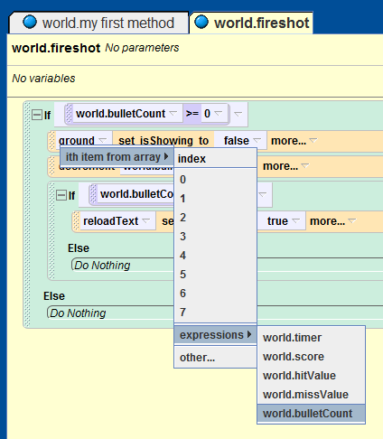

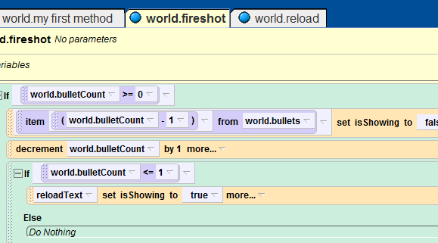
Step 3: Animate the Bullet Counter
Open up the properties for the “ground” object, and find the “isShowing” property.
Drag-and-drop the ground’s “isShowing” property just above the line
and set the value for ground.isShowing to false. This will give us the “---- set isShowing to false” code-bit that we want.
Drag-and-drop the “bullets” array over “ground” in the line that you just added.
From the pop-up menu, select “ith item from array 0.”
Replace “0” with “(world.BulletCount – 1).”

Slide 6
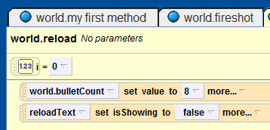
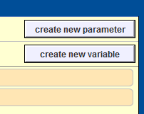
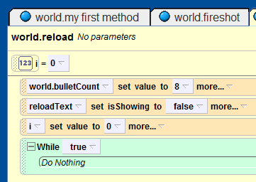
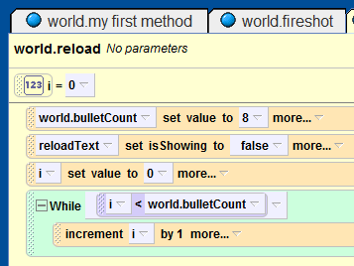
Step 4: Create the Pointer Variable
Open the “world.reload” method in the code editor.
Drag-and-drop the new i-variable to the bottom of the “world.reload” method and set its value to 0.
Add a new while-loop to the “world.reload” method with the condition “true.”
Change the while-loop condition to “i < world.bulletCount”.
Drag-and-drop the i-variable into the while-loop and select “increment world.reload.i by 1” from the popup window.

Slide 7
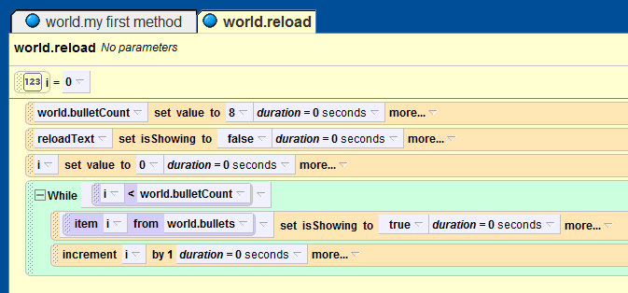
Step X: Reload the Revolver
Similarly to what we did in Step 2, drag ground.isShowing into the top of the while loop from Step 4, but set the value assignment to true.
Drag-and-drop the bullets array over ground, and select “item 0 from world.bullets.”
Replace the “0” with “(i – 1).”
Set the duration for all of the code in reload to zero.

Slide 8
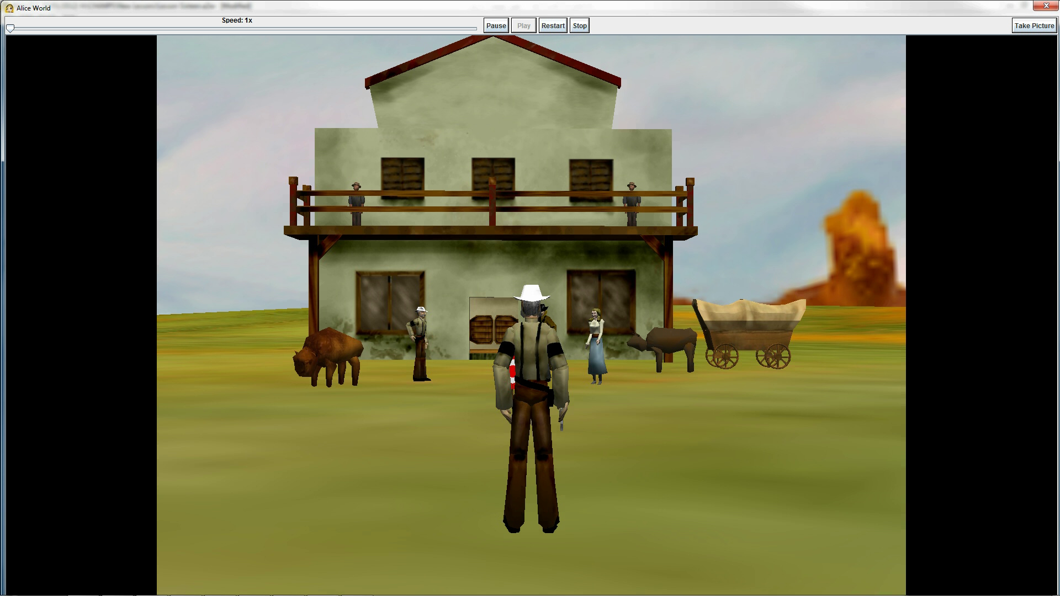
Final Scene

